Slide 1
Annotated Bibliography

Slide 2
The Starting Point!
Today we will be covering the following What is annotated bibliography?
The purpose of annotated bibliography
Questions to consider?
Contents of an annotated bibliography
How to write an annotated bibliography?

Slide 3
What Is An Annotated Bibliography:
Annotated bibliography is summarizing you citations in order to make it easier for your readers to understand the relevance of your sources
This is when you mention a citation and then briefly describe the study, give information about the author, mention the year and state what the study is about.

Slide 4
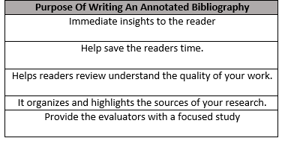
Purpose Of An Annotated Bibliography:

Slide 5
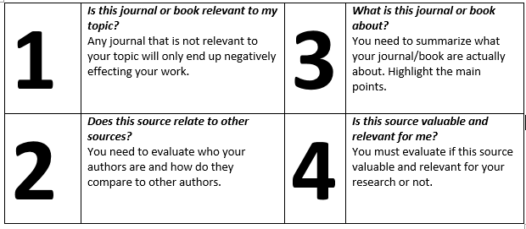
Questions To Consider:

Slide 6
Contents Of An Annotated Bibliography:
Annotated bibliography should include the following content:
Proper citation.
Background of the authors.
Outline the main argument, audience and scope of the text.
Summarize the main argument.
Clarify the methodology of the research.
Conclude what has been presented in the research.
Discuss how the citation is relevant for your work.

Slide 7
How To Write An Annotated Bibliography:
Step 1:
Proving your source’s credibility is important therefore you have to consider your author’s qualifications, to understand the author’s reliability. Moreover the credibility of the journal also holds importance. An unknown journal will not be credible and would not be a good enough source to cite.

Slide 8
How To Write An Annotated Bibliography:
Step 2:
The type of annotation you will be using.
Indicative or descriptive Describes the source and provide you with a quick summary of the source.
Informative or summary
Describes the main idea or argument that the topic has covered.
Evaluation
Here reliability is taken into account and you would want to discuss any biases of the paper.
Combination Combines different bibliography types

Slide 9
How To Write An Annotated Bibliography:
Step 3:
Writing style of annotations can change according to the citation format that you are required to follow in your assignment.
Citation formats include APA, MLA and Chicago style.

Slide 10
How To Write An Annotated Bibliography:
APA Style:
APA Style demands reference entry and annotation to be double spaced and left aligned. The annotation follows the reference in the next line. Citations are automatically formatted in APA citation generator when you download the bibliography.

Slide 11
How To Write An Annotated Bibliography:
MLA Style:
The reference and the annotation are both double-spaced and left-aligned.
The annotation itself is indented 1 inch. If there are two or more paragraphs in the annotation, the first line of each paragraph is indented an additional half-inch, but not if there is only one paragraph.
Your citations will be properly formatted if you are using MLA Citation generator.

Slide 12
How To Write An Annotated Bibliography:
Chicago Style:
The entry should be single-spaced and have a hanging indent.
The annotation should be indented, double-spaced, and left-aligned.

Slide 13
DO’s & Don'ts!

Slide 14
LET’S MAKE A CHECKLIST, SHALL WE?
It is important to organize your references.
Annotated bibliography can have different types.
Annotations are a brief description of the references that we have provided.

Slide 15
GOOD LUCK!

